Slide 1
Mass Mailer Attack
(using email harvesting)

Slide 2

What is MASS MAILER ATTACK
Mass Mailer attack is a type of social engineering attack.
Large number of spam mails are sent to different harvested e-mail addresses usually containing malicious links/scripts.
The attack is also used to send a large number of spam e-mails to a single e-mail address possibly trying to crash the inbox.
Even if the attack doesn’t crash the inbox service of a user it does fill the inbox of a user to an extent that it is difficult for him/her to access important emails.
It is also called E-Bombing or SMS Attack.

Slide 3

TWO VARIATIONS
Type 1
E-mail attack on a single e-mail address
Type 2
E-mail attack using a mass mailer

Slide 4

EMAIL HARVESTING
Email harvesting is the process of obtaining a large number of email addresses through various methods.
The purpose of harvesting email addresses is for use in bulk emailing or for spamming.

Slide 5

MASS MAILER
Large number of e-mail addresses are harvested using a harvesting a tool and are stored in a file for later use.
The file containing harvested e-mails is used as an input to a mass mailer which then sends an e-mail specified by the hacker to all the listed e-mail addresses.

Slide 6
TOOLS USED
MSF CONSOLE
SE-TOOLKIT
METASPLOIT FRAMEWORK
EMAIL COLLECTOR
PLATFORM : KALI LINUX

Slide 7
MSF-CONSOLE : Interface to the Metasploit Framework (MSF)
SETOOLKIT : The Social-Engineer Toolkit (SET) is specifically designed to perform advanced attacks
METASPLOIT FRAMEWORK: Enables you to write, test, and execute exploit code.
EMAIL COLLECTOR : Email information gathering tool.
.

Slide 8

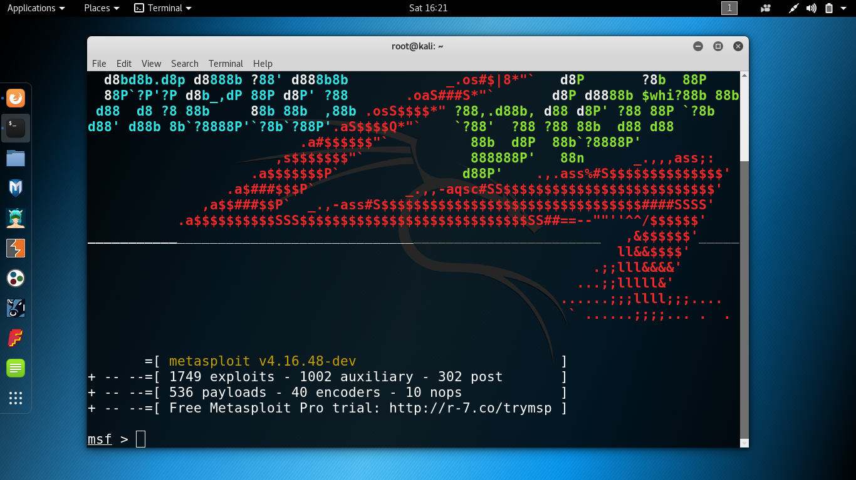
LET’S GET STARTED.

Slide 9
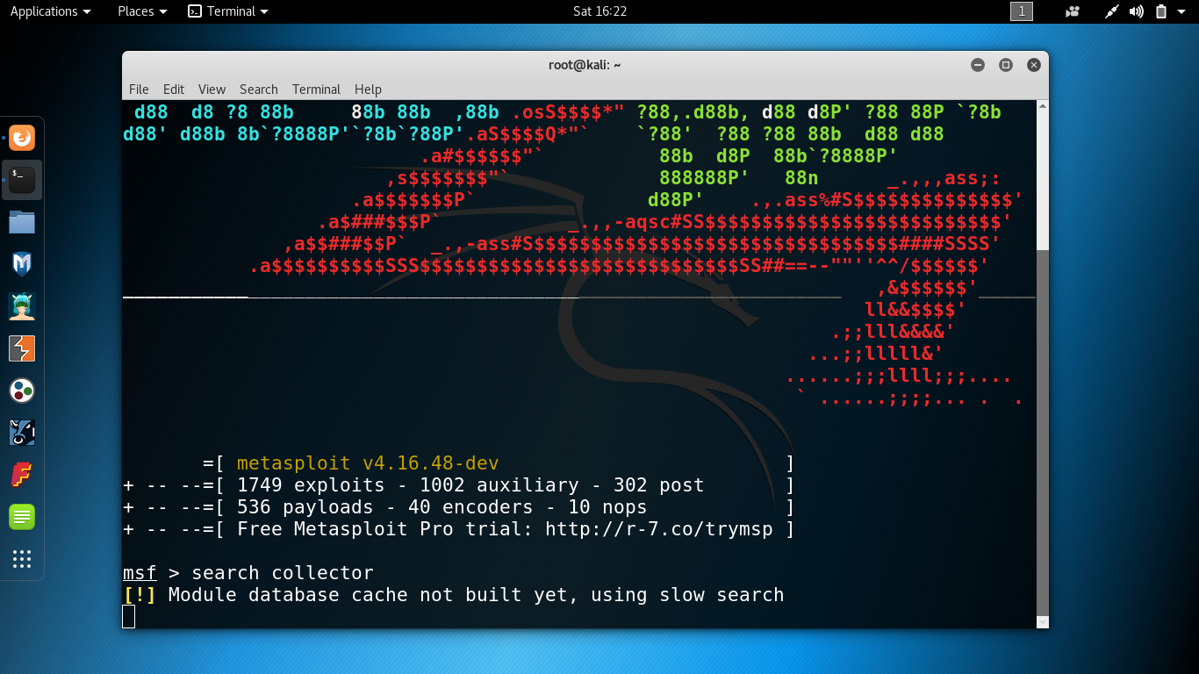
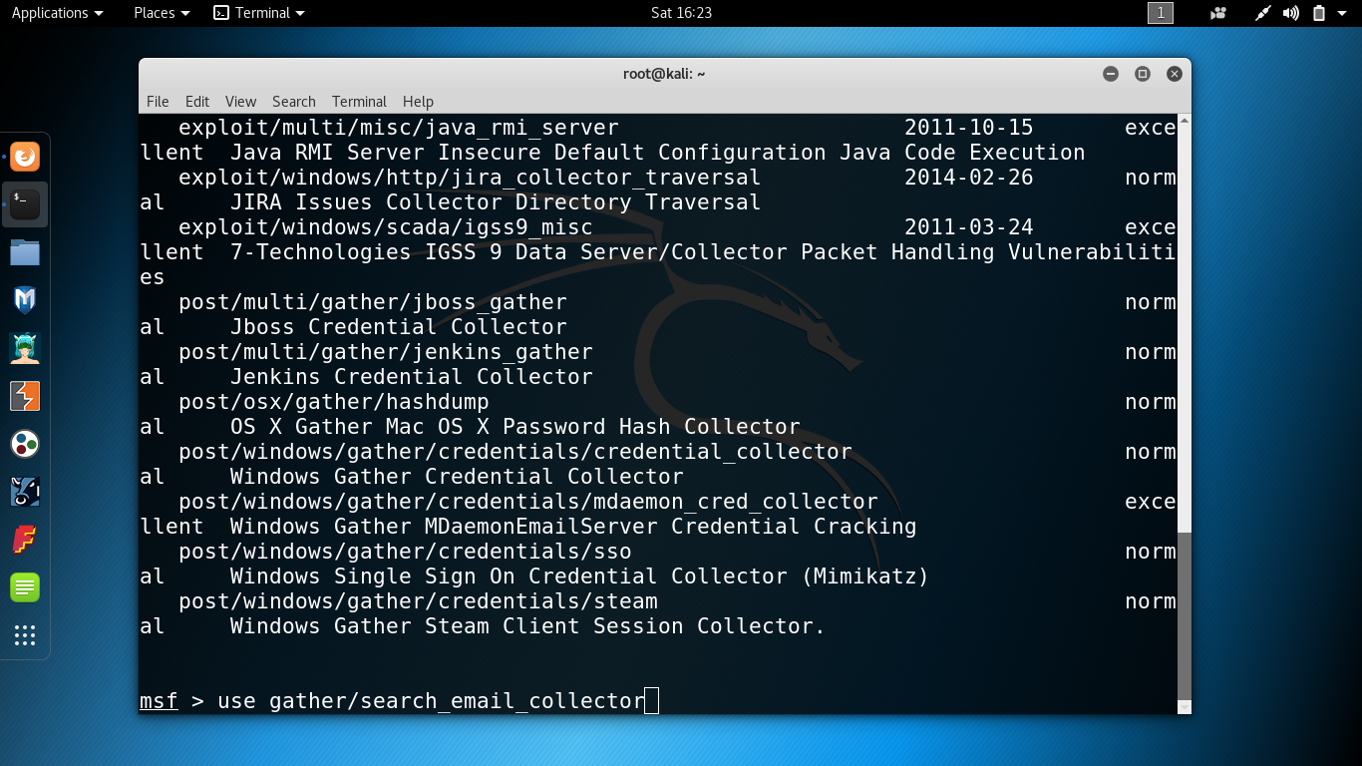
LET’S GET STARTED.

Slide 10
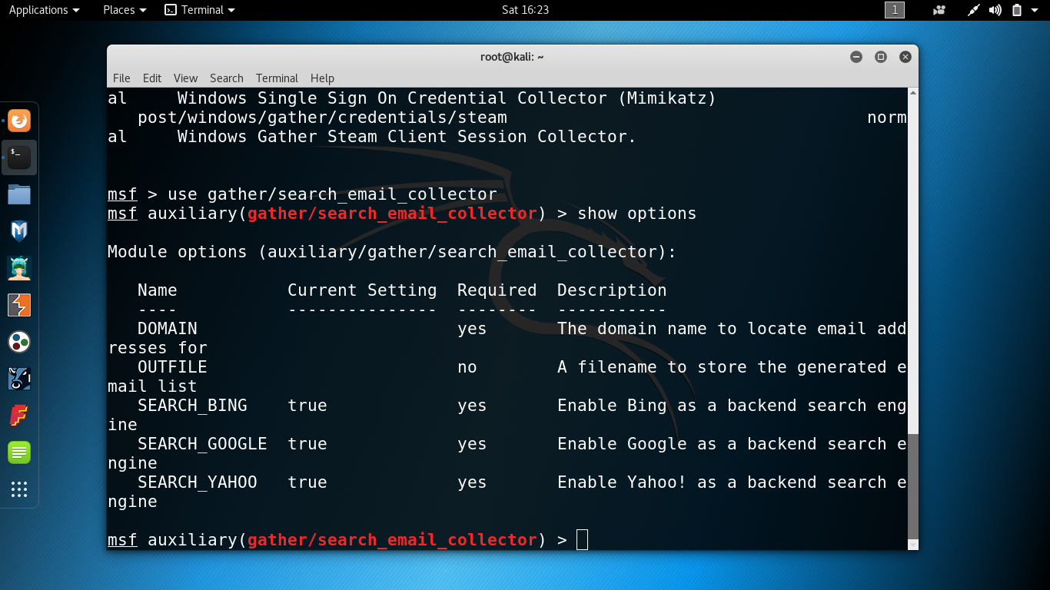
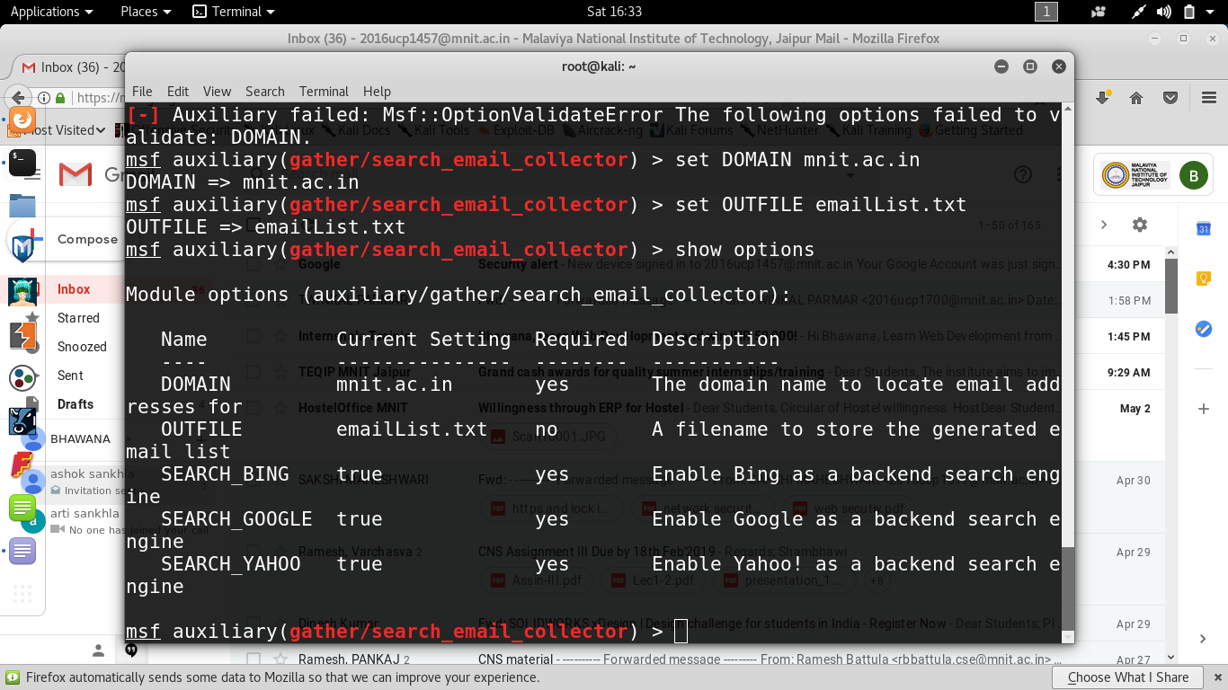
LET’S GET STARTED.

Slide 11
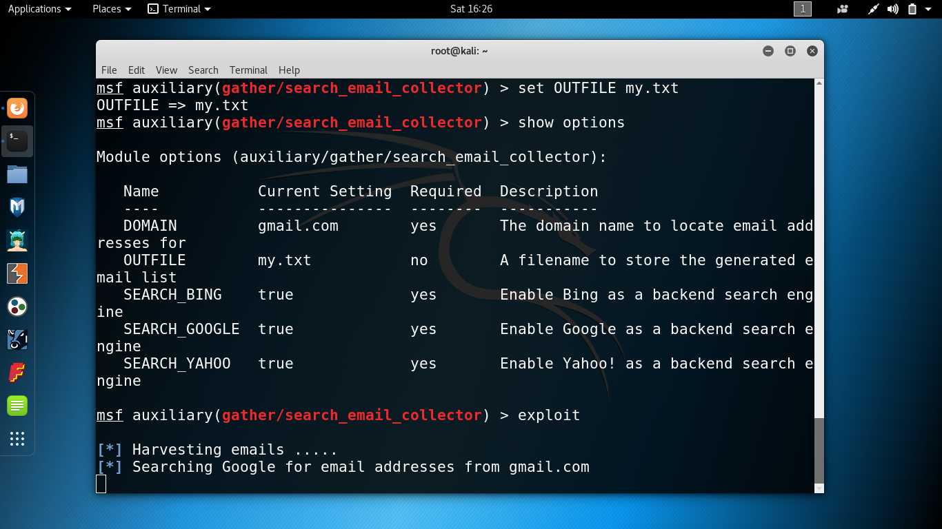
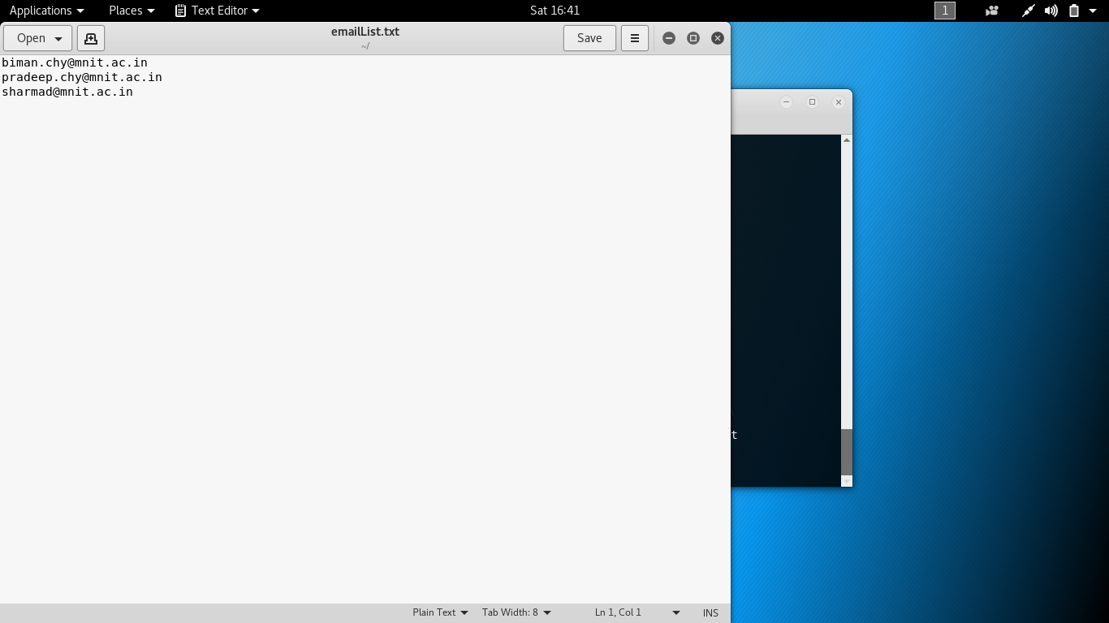
LET’S GET STARTED.

Slide 12
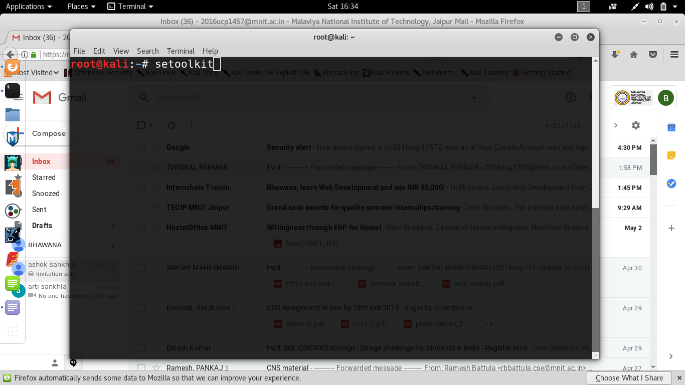
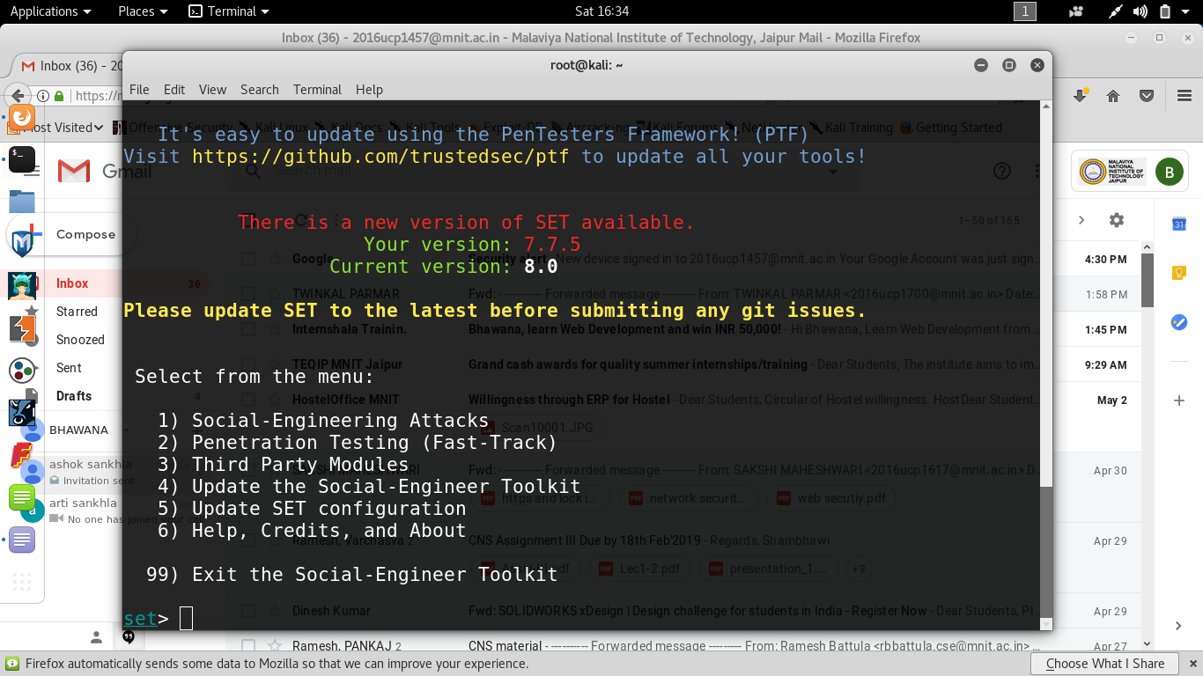
LET’S GET STARTED.

Slide 13
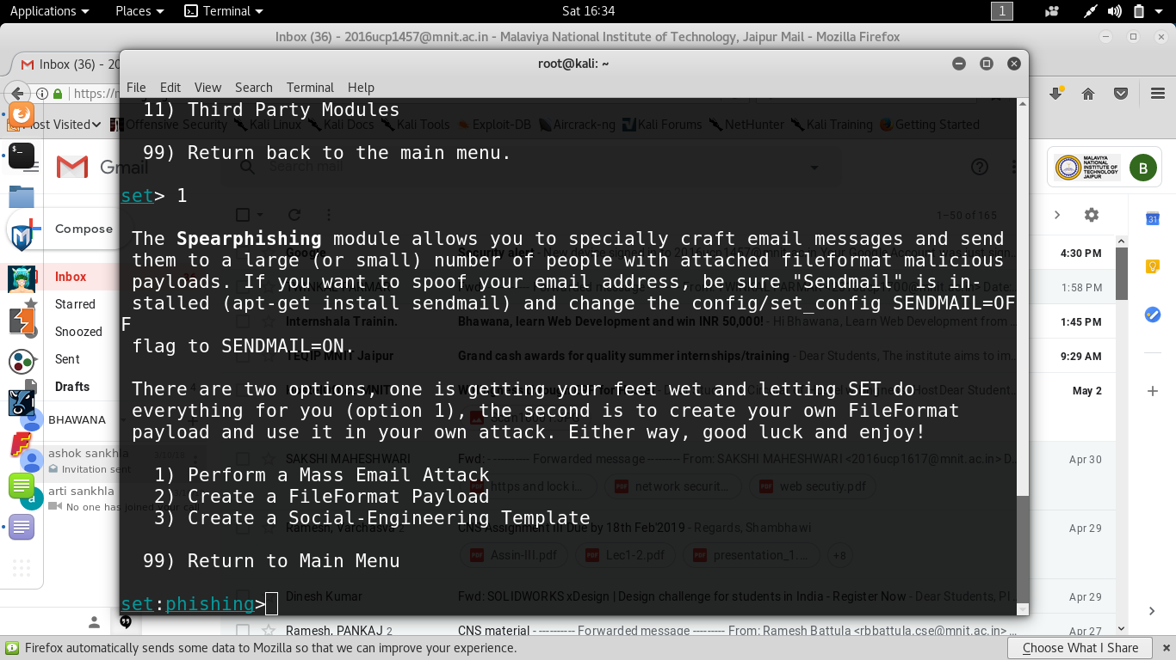
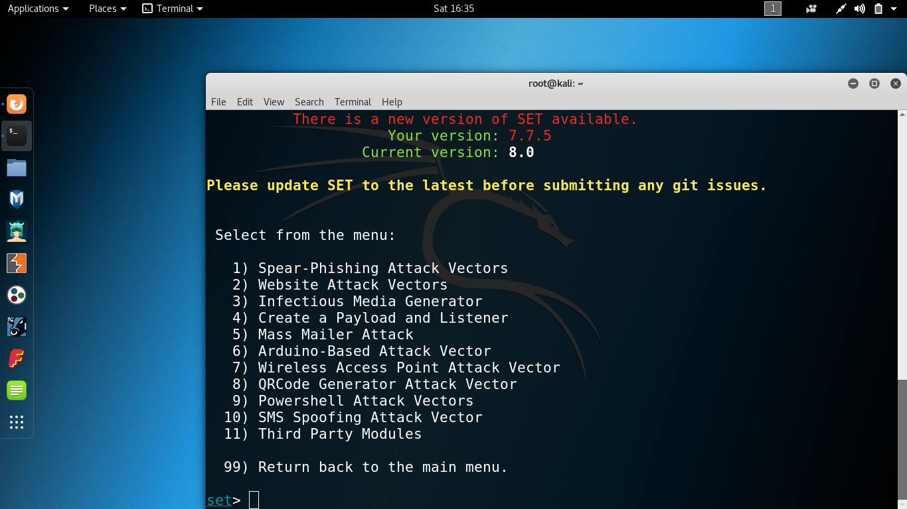
LET’S GET STARTED.

Slide 14
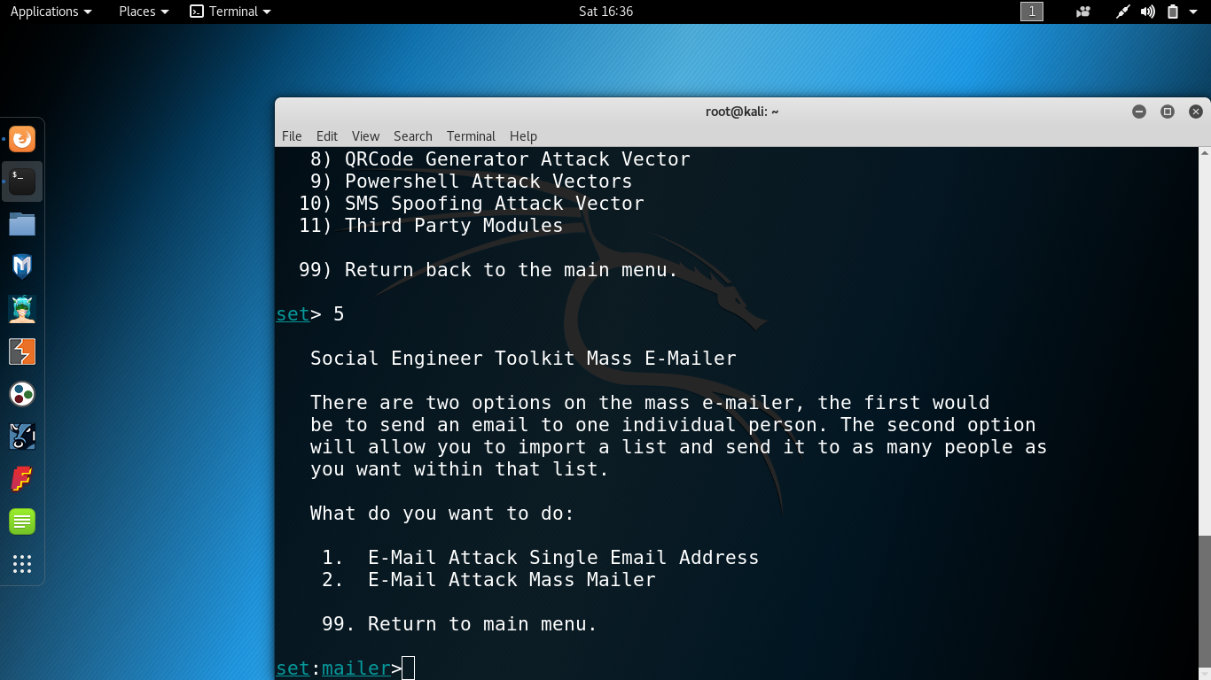
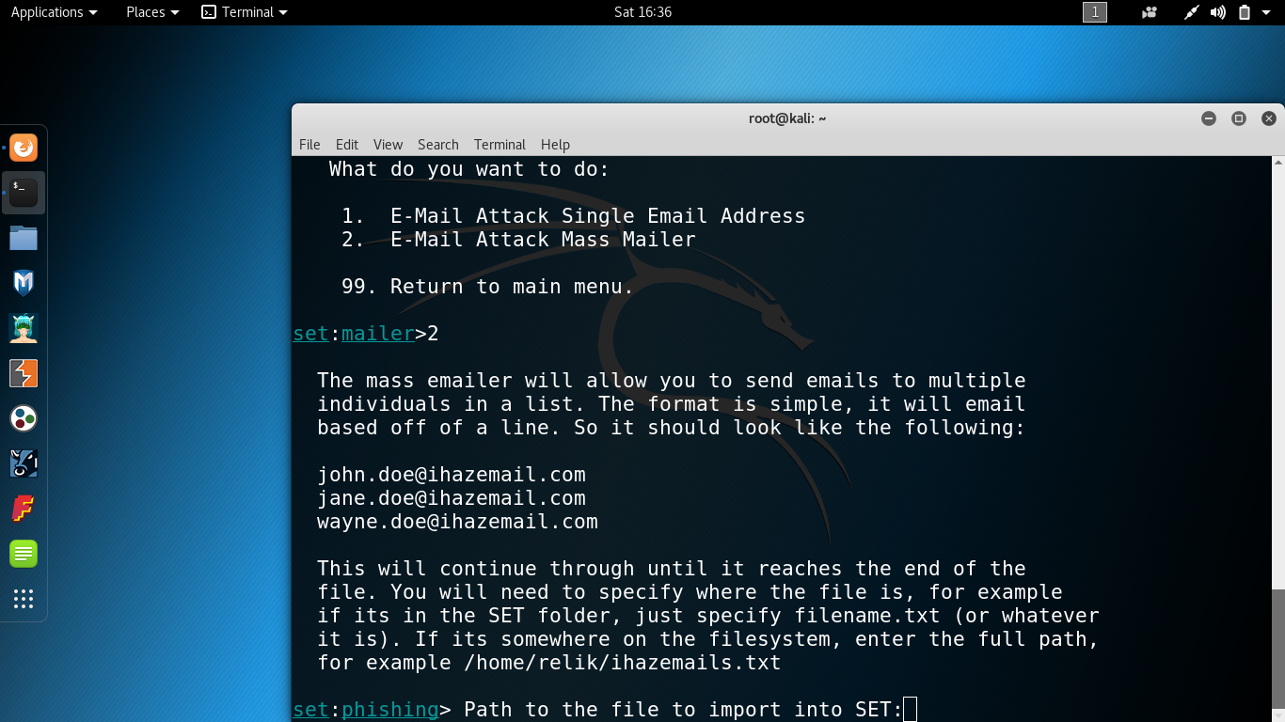
LET’S GET STARTED.

Slide 15

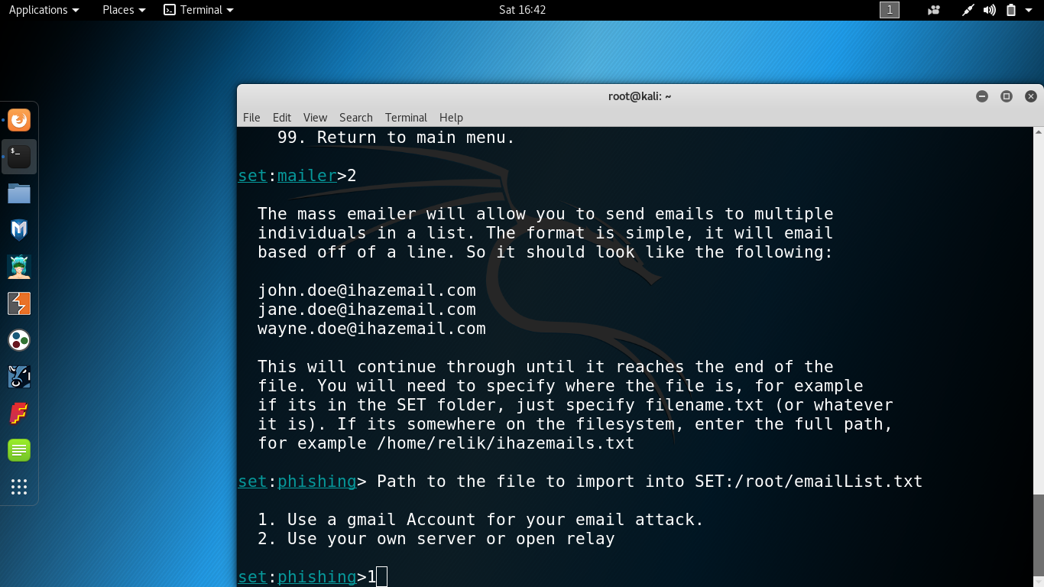
LET’S GET STARTED.

Slide 16
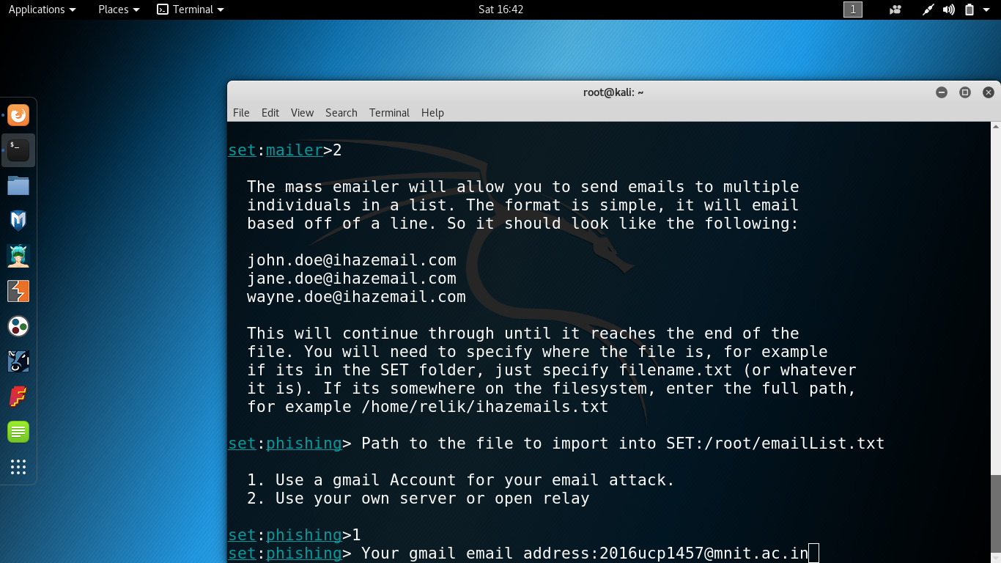
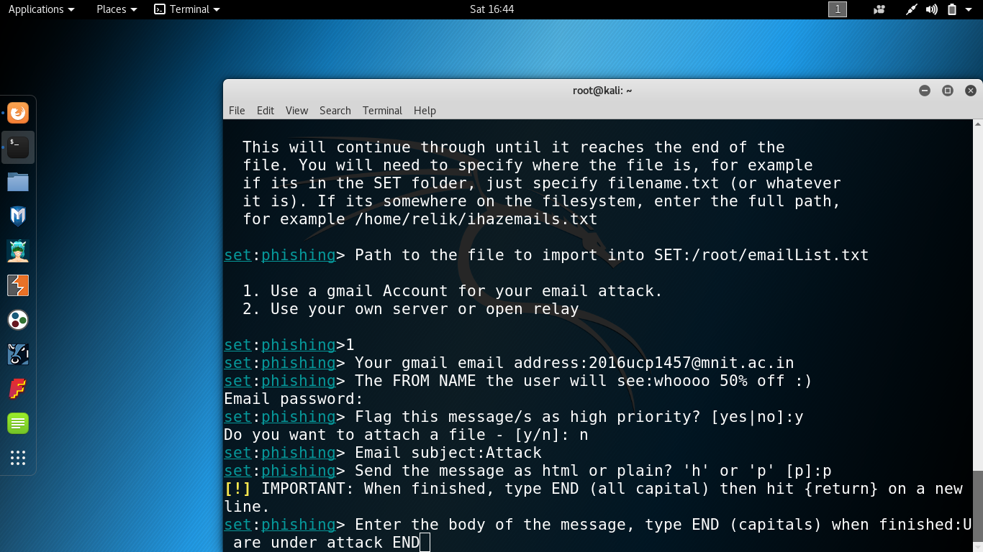
LET’S GET STARTED.

Slide 17
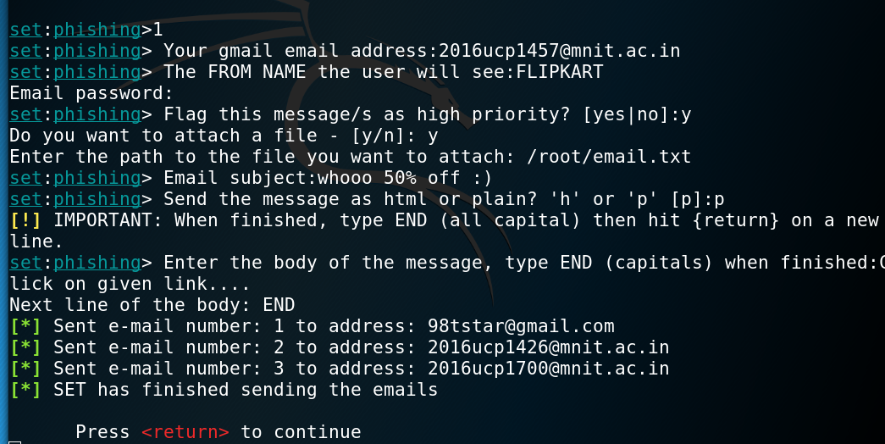

LET’S GET STARTED.

Slide 18
THANK YOU
SUBMITTED BY:
2016ucp1700 TWINKAL PARMAR B(3,4)
2016ucp1457 BHAWANA SANKHLA B(1,2)
2016ucp1388 SHUBHAM ARORA A(3,4)

